Slide 1
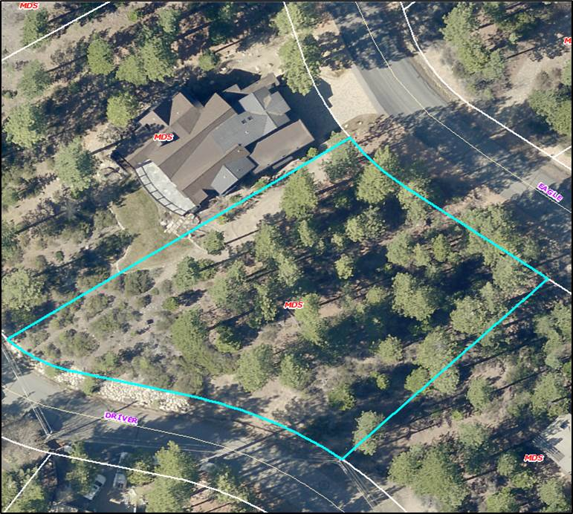
Variance Case WPVAR17-0005
Washoe County
Board of Adjustment
August 3, 2017
McLendon Residence

Slide 2
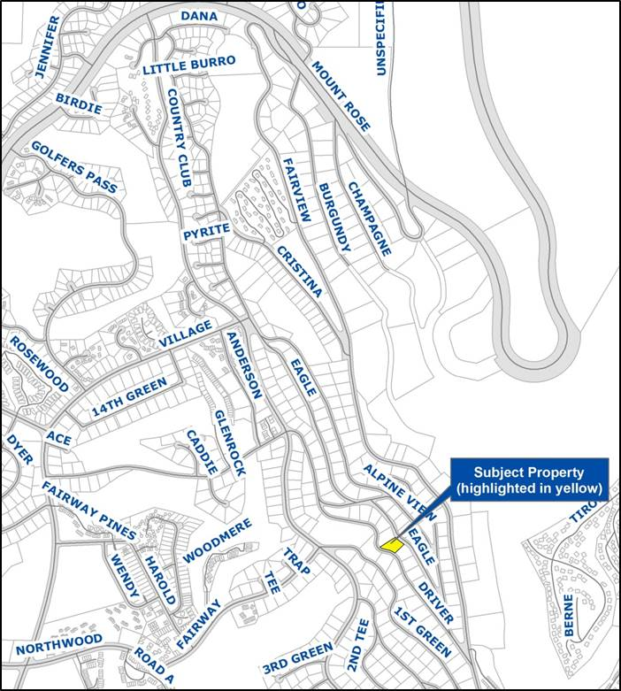
Location and Zoning
Incline Village
West of Fairview
487 Eagle Drive
Medium Density Suburban
0.64-acres

Slide 3
Project Overview
Required front yard setback: 20-feet
Requested front yard setback: 3-feet
26-feet from Eagle Drive edge of pavement

Slide 4
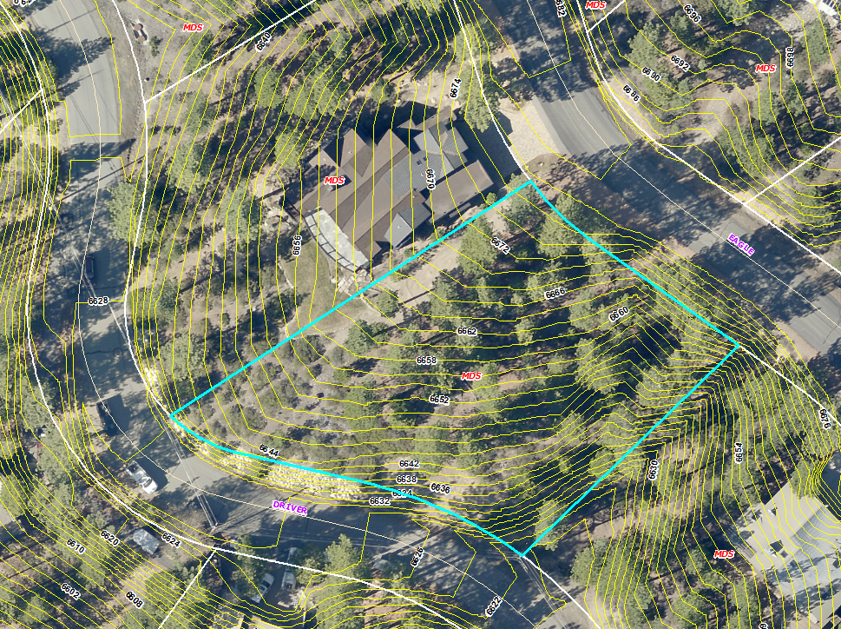

Slide 5
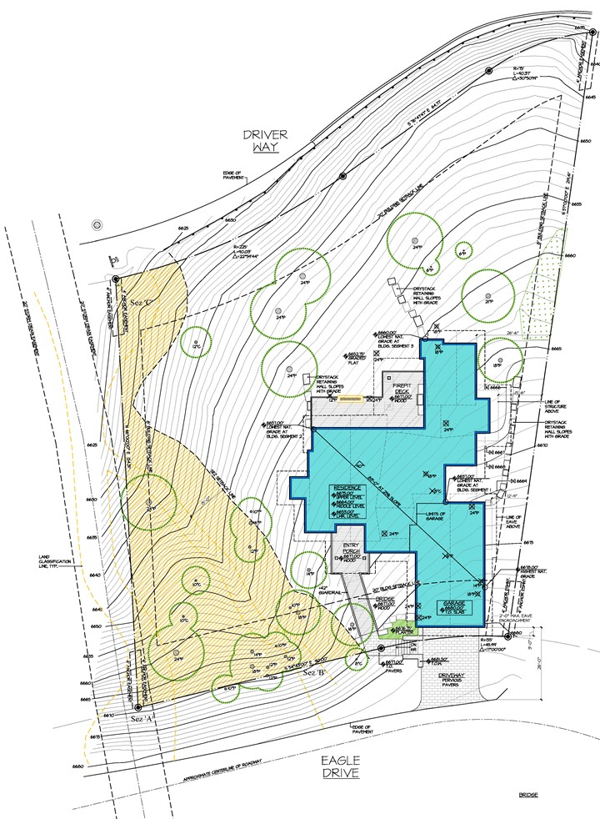
Stream Environment Zone

Slide 6
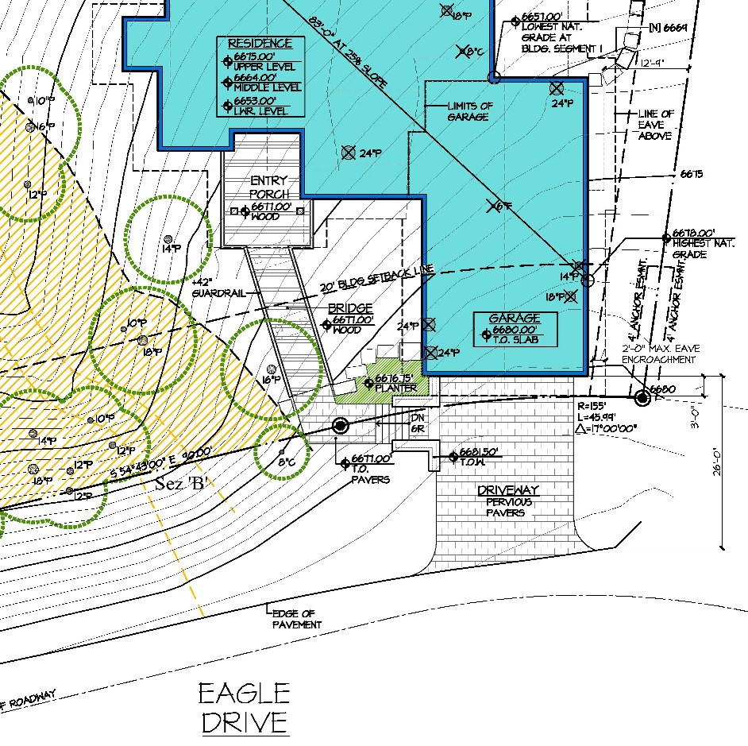
Edge of proposed structure (3’ from front property line)
20’ front yard setback
Property line
Edge of pavement

Slide 7
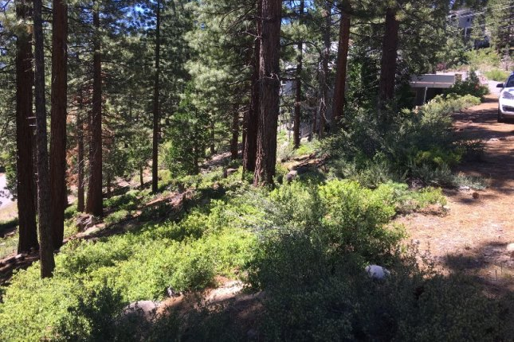
Site Photo
25% average slope (approx.)

Slide 8
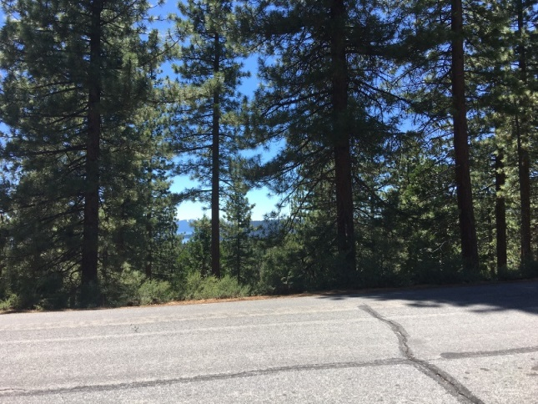
Site Photo

Slide 9
Evaluation
Significantly constrained
Steep slopes (average 25%)
Stream Environment Zone reduces property frontage
Stepped-down building design
26-feet from edge of pavement
Side setback of 8-feet will be maintained

Slide 10
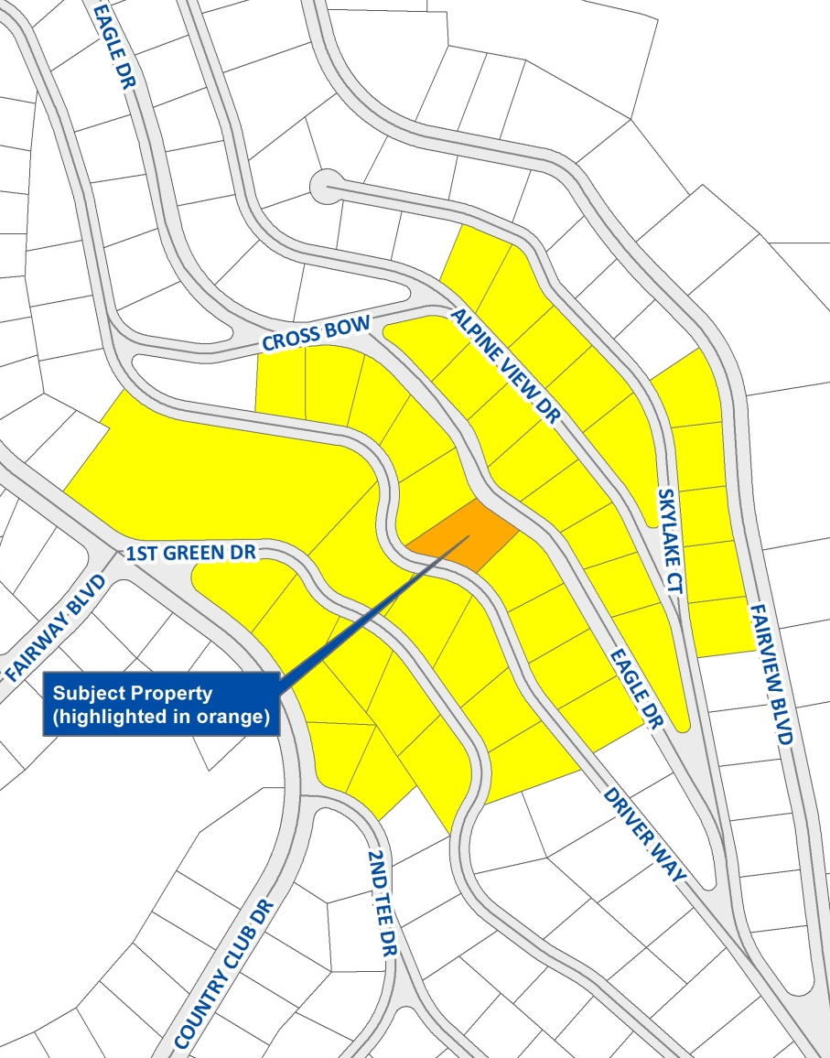
Public Notice & CAB
39 property owners received notice
July 24 Incline Village/ Crystal Bay CAB
Concerns voiced about side setbacks and tree removal
CAB voted to submit comments to Board
2 other comments received

Slide 11
Reviewing Agencies
Washoe County
Planning & Building
Engineering & Capital Projects
Health District
Tahoe Regional Planning Agency
Incline Village General Improvement District
North Lake Tahoe Fire Protection District
Regional Transportation Commission
Washoe-Storey Conservation District
AT&T, NV Energy and Charter Communications

Slide 12
Variance Findings
Special circumstances
No detriment
No special privileges
Use authorized
Recommendation: Approval with conditions
Motion: Page 12 of staff report

Slide 13
QUESTIONS?

